Slide 1
SIT216 User Centred Design
Topic 1
Introduction to Interfaces, Interaction and Design & Understanding Users and What They Want

Slide 2
Introduction
Covered in this topic:
Let’s start with a few examples
What impacts the most on users (humans): interfaces, interaction and design decisions
Types of users
User Personas
Describing a problem from the perspective of users.

Slide 3
A few examples
0

Slide 4
Activity - A Few Examples
To start:
Understanding what the course is about through a few examples.

Slide 5
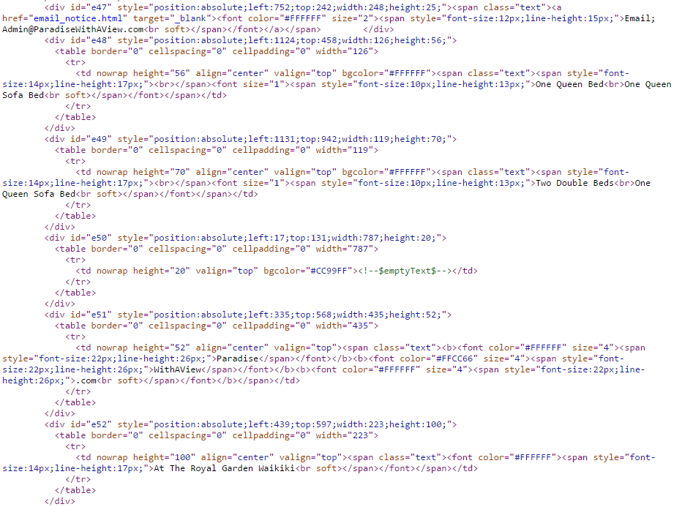
Activity - A Few Examples

Slide 6
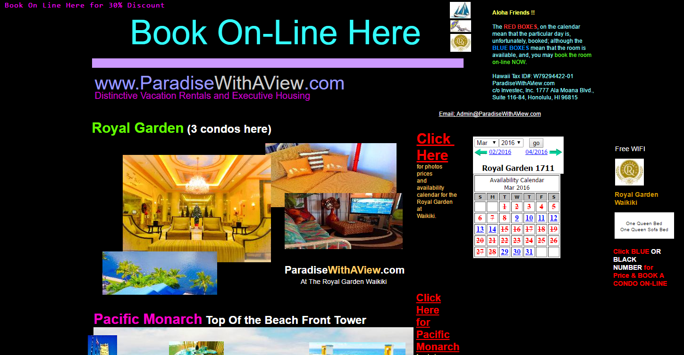
Activity - A Few Examples
http://paradisewithaview.com/

Slide 7
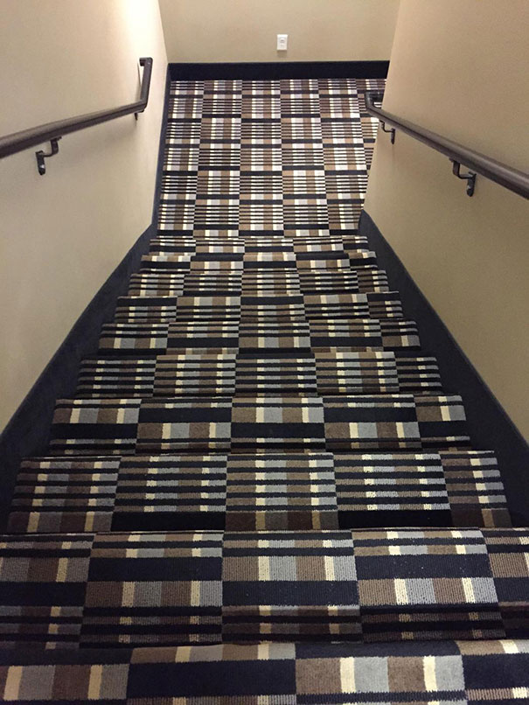
Activity - A Few Examples
What is wrong with this photo?
What is the problem?
How could it be resolved?
We need to be user (human) focused!
Source: https://www.interaction-design.org/literature/article/design-failures

Slide 8
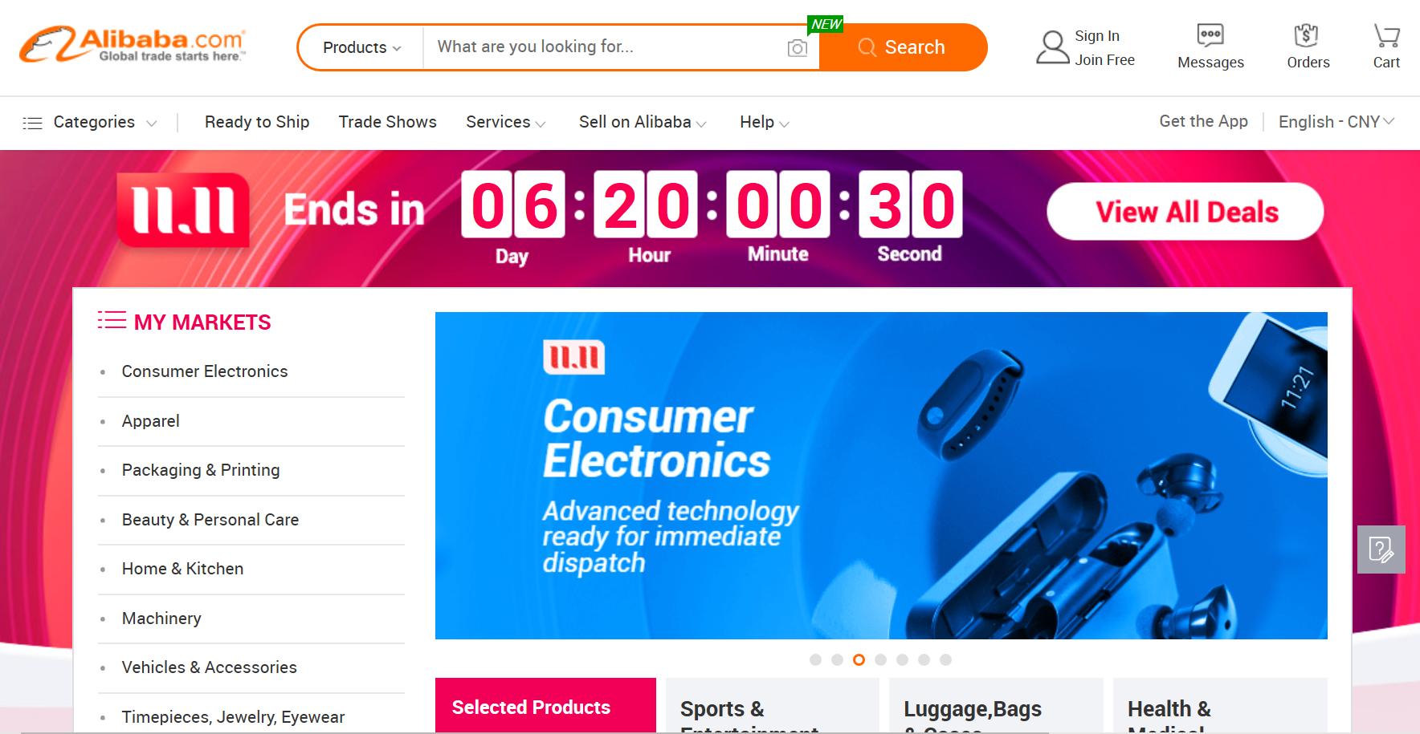
Activity - A Few Examples
光棍节 – Singles’ Day @ Alibaba

Slide 9
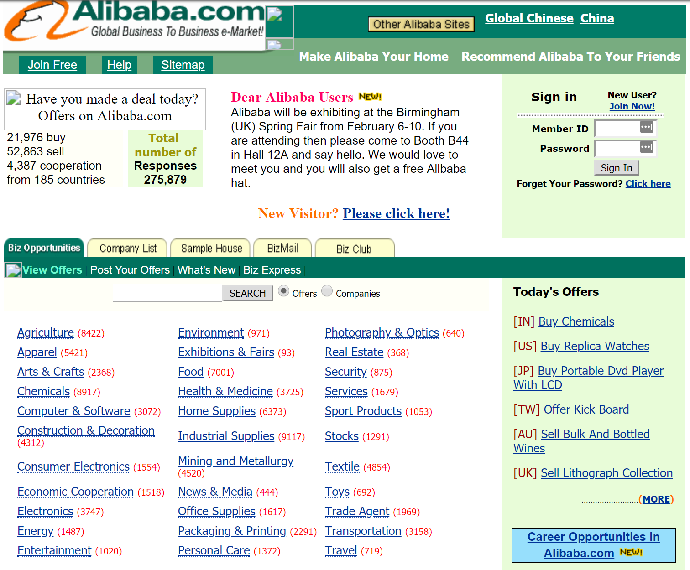
Activity - A Few Examples
Talking to students around you, discuss:
Has the website/app undergone major changes to the way it looks?
What has changed?
… and here’s a snapshot of what the site looked like in February 2000 (thanks to the Web Archive)

Slide 10
Activity - A Few Examples
Talking to students around you:
Are you able to find what you are looking for quickly and easily with the current website/app? Is it easier on your phone or laptop?
On big occasions like Singles’ Day, how well does the website/app work?
Have you ever encountered problems finding or paying for your goods?
What were they?
What happens if a website/app like Alibaba is confusing for users (humans) to understand?

Slide 11
Activity - A Few Examples
Also…
Think about other websites/apps/products/systems you have interacted with that you consider look good but you soon realised that they were missing some functions so they could not do what you wanted (in your opinion).
Note:
The name the website/app/product/system, and
Specify/list the missing functionality
We will share/discuss your findings with the class.

Slide 12
INTRODUCTION TO USER CENTRED DESIGN
1

Slide 13
Introduction to User Centred Design
From the earlier examples and discussion:
Interfaces require consideration of both the front-end (user needs) and back-end (providing functionality).
Interaction initiated by users is facilitated by the interface but requires a robust back-end capable of translating these requests.
Design covers both the interface and interaction and directly affects satisfying user needs and goals.
User Centred Design (UCD) encompasses having an understanding of user needs and requirements, and focusing the design and development of new systems on helping ensure a positive relationship with computers/technology (products and services).

Slide 14
Activity - Introduction to User Centred Design
Consider how you search for information online
Think about, and record the individual (and specific) actions you take
How do you know when you have found the answer?
How long does this take?
Write a brief (3-4 sentence) answer
The concept of ‘task analysis’ will be covered in a future class

Slide 15
Interfaces
2

Slide 16
What is an Interface?
Software that shapes the interaction between the user/audience and the situation
A translator between the user/audience and the situation
So:
The relationship governed by the interface is a meaningful one (characterised by meaning and expression as opposed to technological bells and whistles!)

Slide 17
Application Interfaces
An application is “self-contained” in that it builds its own interface.
The application interface operates independently of any other application running on the computing device.
Everything the user needs to do is contained within the application interface.
Activity: name 2 application interfaces

Slide 18
Hosted Interfaces
Hosted interfaces are user interfaces designed to run within the interface of special applications such as web browsers.
These systems therefore have two interfaces:
the application interface, which is used to control the client;
and the hosted (or client) interface, which provides the user with the interface needed to perform the required tasks.
Activity: name 2 hosted interfaces

Slide 19
Interaction
3

Slide 20
Interaction
Interaction refers to both the physical and cognitive actions performed by users when they use an interface.
Physical interaction includes:
Pointing and clicking
Typing
Drag and dropping
Scrolling
Listening
Watching
Tapping
Gestures
Speaking

Slide 21
Activity - Interaction
Provide 1 example of a website/app/software program for each type of physical interaction:
Pointing and clicking
Typing
Drag and dropping
Scrolling
Listening
Watching
Tapping
Gestures
Speaking

Slide 22
Interaction
Cognitive interaction includes:
Making decisions about what parts of the screen with which to interact
Making decisions about how to interact with the interface
Interpreting messages and prompts delivered through the interface
Processing the information provided via the interface.

Slide 23
design
4

Slide 24
What is Design?
Design is the difference between doing it, and doing it right. (Mark Fisher, UK MP)
In design you have to think about what other people will like. (Ghisli, age 10)
Design is a plan for arranging elements in such a way as to best accomplish a particular purpose. (Charles Eames)

Slide 25
Core Skills of Design
From Charles Eames (in Bill Moggridge’s Designing Interactions):
To synthesise a solution from all of the relevant constraints, understanding everything that will make a difference to the result.
To frame, or reframe, the problem or objective.
To create and envision alternatives
To select from those alternatives, knowing intuitively how to choose the best approach
To visualise and prototype the intended solution

Slide 26
Activity - Importance of Design
Together with the students around you (groups of 2-4), find out about Donald Norman
Tell me about his background
Tell me about his achievements
Find some examples of his work or research projects
Tell me why he is an important person in the field of ‘User Centred Design’
We will share some of the information you find with the rest of the class.

Slide 27
Usability
5

Slide 28
Usability
Usability is concerned with making systems easy to learn and easy to use. This can lead to improved performance in the workforce.
Poorly designed interfaces can:
require extra user effort
cause misuse or non-use
lead to errors and perhaps failures
Sometimes referred to as ‘user-friendliness’.

Slide 29
The Two Keys to Usability
Factors that have the most influence on usability are visibility and affordance.
Visibility and affordance help the user interpret and predict the effect of particular actions.
Can be learnt, but in truly intuitive systems, the visibility and affordance are innate.

Slide 30
Visibility
The controls used in an interface need to be visible (identifiable), with good mapping (relationships) with their effects.
A usable interface needs to make the interaction elements (controls) visible to the user.
Not only must the user be able to see the controls but they must be able to determine what control does what.

Slide 31
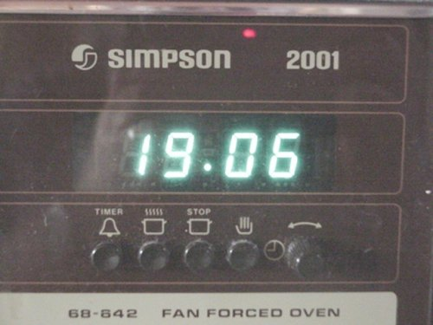
Activity - Assess the visibility
Notes:
L to R
Timer set button (bell symbol). Press this button to adjust or observe the timer
Cooking time set button (steaming oven symbol) Press this button to adjust or observe the cooking time
Cooking time set button (oven symbol with STOP written over it) Press this button to adjust or observe the stop time
Manual control button. (A hand symbol, with the palm towards you) Press this button to revert to manual control of the oven
Time set knob. Twist this knob clockwise to increment the time and anti-clockwise to decement the time. When the minutes reach 0 or 59 they will roll over and the hours will increment/decrement.

Slide 32
Now change the time
Notes:
Press and hold any two of the timer, cooking time or stop time buttons. Use the time set knob to set the time. Release the two buttons. The clock will start running (with a zero second count) from the time you release the buttons.

Slide 33
Affordance
The appearance of controls must afford (suggest) their functionality, i.e. the way they work.
One can either mimic real-world objects or emulate their critical aspects.
Affordances are not intrinsic, but depend on the background and culture of the user.

Slide 34
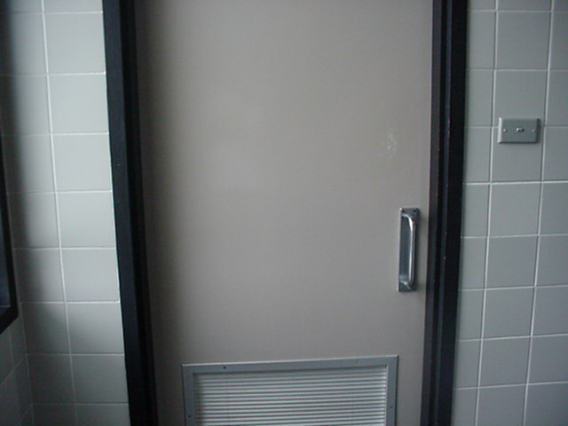
What is the Affordance?

Slide 35
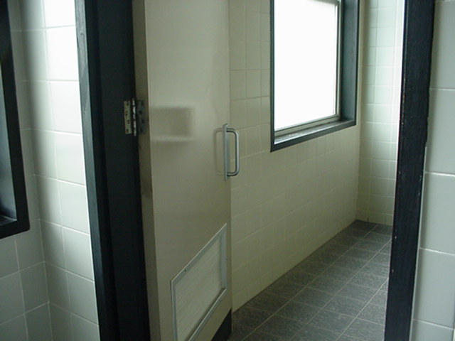
But look…

Slide 36
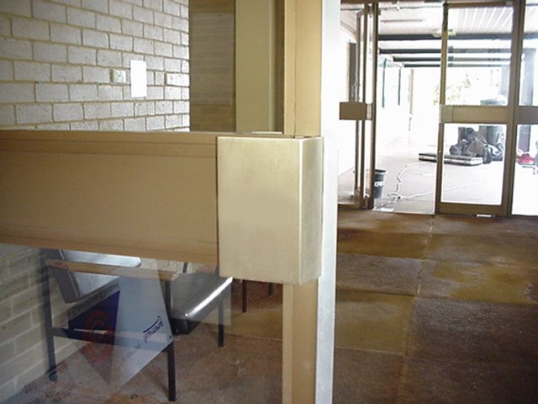
Activity - What is the Affordance?

Slide 37

So labels are used…

Slide 38
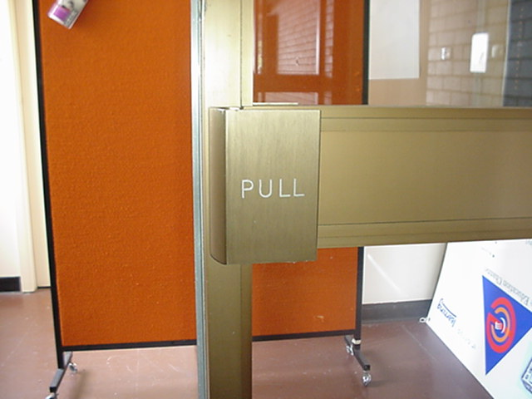
…and the other side

Slide 39
Understanding Users
6

Slide 40
Understanding Users
Designers need to understand people.
In this context, “people” represent:
clients
users
“Understand” represents:
knowing how they work
knowing how they think

Slide 41
Understanding Users
How do designers “understand” how people work and think?
This usually represents the major components of task and requirements analysis.
Techniques include:
interviews
surveys
observations
“experience”, and
principles or theory.

Slide 42
Understanding Users
Designers must recognise the diversity of people who make use of interfaces:
some will be able to respond immediately, others will require time to think.
some will focus only on what needs to be done, others on what should be done.
some will use their feelings to express a point of view, others will use logic.
some will act decisively (yes/no) and not change their view, while others will perceive when plans need to be changed.

Slide 43
Understanding Users
Designers must recognise the diversity of people who make use of interfaces:
Cultural relativism
Quick activity:
Think of the other students in your class/look around at those with you…
Do you think that they represent the complete spectrum of users of technology? Why? Why not?
Notes:
2 minute activity, not timed. Geelong lead with microphone action. Sophie will recap any online comments.
Wrap up comments
some will be able to respond immediately, others will require time to think.
some will focus only on what needs to be done, others on what should be done.
some will use their feelings to express a point of view, others will use logic.
some will act decisively (yes/no) and not change their view, while others will perceive when plans need to be changed.
There are many other ways to understand users.
some like just know what to do, others want to see the goal first
some like “colour, glitz and glam”, while others don’t care
some want to know how it works, others just want to know that it works
some people read, some hear, some see, and some must do

Slide 44
Understanding Users
There are many other ways to understand users.
some like just know what to do, others want to see the goal first
some like “colour, glitz and glam”, while others don’t care
some want to know how it works, others just want to know that it works
some people read, some hear, some see, and some must do

Slide 45
Types of users
7

Slide 46
Types of Users
In any setting/environment designers are tasked with implementing changes to current (or new) systems. They may meet a diverse range of users that have specific knowledge (but not with the system itself)
Part of their job (this isn’t the case for all designers) may be to best determine and investigate user needs and requirements
As a designer, you will quickly realise how users (or workers, but most importantly, humans) vary in their understanding of digital systems.

Slide 47
Activity - Types of Users
Consider your use of MS Word. Rate your expertise (poor, OK, good) in:
changing the font of a portion of text
inserting an image
merging two tables together into a single table
using a formula to sum a column of numbers
writing mail-merge instructions into your document

Slide 48
Activity - Types of Users
How many of our class are:
poor at everything?
good at everything?
Do you expect all inexperienced users to be poor at all tasks?
Do you expect all experienced users to be good at all tasks?

Slide 49
Personas
8

Slide 50
Personas
Personas are used to develop a precise description of users and their requirements.
Being a victim of a problem does not empower the user to see a solution.
Personas create imaginary people and we design for them.

Slide 51
Personas
Personas combine characteristics of real people into one or more “imaginary” people.
Personas are useful in helping to guide decisions about a product, such as features, interactions, and visual design.
Personas always use a photo of the “person”
We remember things visually
We build “mental models”

Slide 52
Personas
Describe the person
You cannot create a description of a typical user, so just describe an imaginary user
Describe their skill levels realistically
Describe what the person does and what they will want to do with the interface
Personas, when combined together, build the functionality of the system

Slide 53
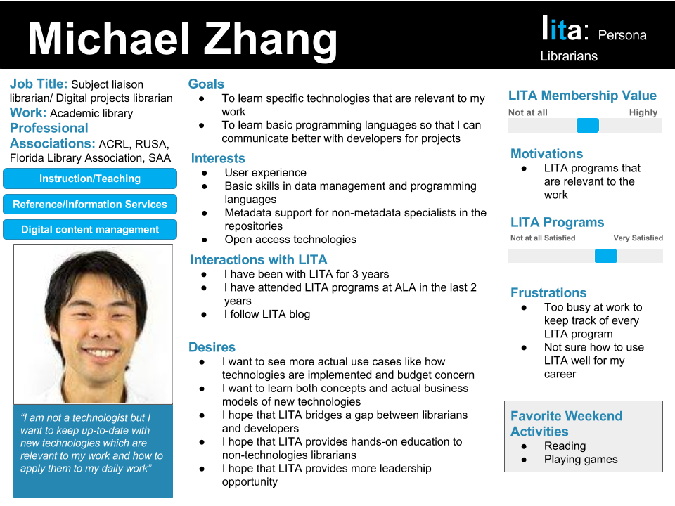
Personas
Notes:
Describe the person
You cannot create a description of a typical user, so just describe an imaginary user
Describe their skill levels realistically
Describe what the person does and what they will want to do with the interface
Personas, when combined together, build the functionality of the system

Slide 54
Personas
Talking to potential users: interviews or surveys
Prior project work
Similar projects if none prior; do your research
Define patterns in user base
A persona could be as simple as: Photo, Name, Description, Users, Problems, Goals
A collection of users, can be defined into a persona or user type

Slide 55
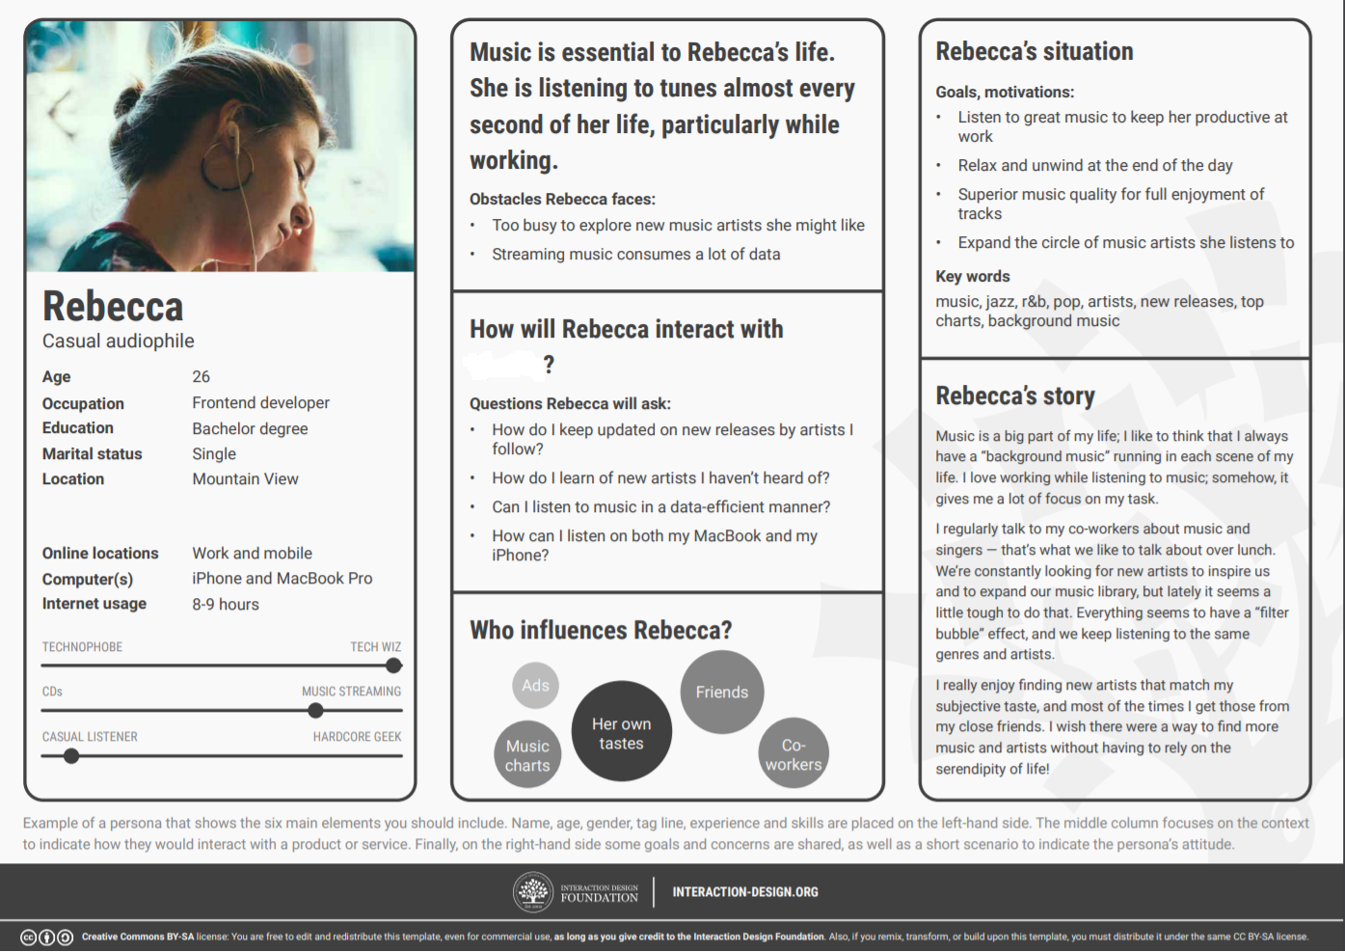
Activity – Personas
What app/type of app is being considered in this persona?
Drawn from: https://www.interaction-design.org/literature/topics/user-personas
Notes:
5 minute activity: Geelong and Burwood (timed – Sophie to setup)
Geelong to take questions from the chat, Burwood to discuss the persona, it’s components, and Identity the product this persona was developed for (see next slide notes)

Slide 56
Personas
There is always a primary persona
The main user of the system
There are usually two or three primary personas because one persona can never capture all functionality
There will always be secondary personas
Secondary personas are occasional users of the interface

Slide 57
Advantages
Said to be cognitively compelling because they put a personal human face on otherwise abstract data about customers.
By thinking about the needs of a fictional persona, designers may be better able to infer what a real person might need.
Easy to communicate to developers and others to absorb customer data in a palatable format.

Slide 58
Benefits
Help team members share a specific, consistent understanding of various audience groups.
Data about the groups of users can be put in a proper context and can be understood and remembered as coherent stories.
Team members’ solutions can be guided by how well they meet the needs of individual user personas.

Slide 59
Benefits
Specific, consistent understanding of various audience groups.
Proper context: coherent stories.
Solution meets individual user personas.
Prioritised features to meet personas.
Human connection.
Notes:
Help team members share a specific, consistent understanding of various audience groups.
Data about the groups of users can be put in a proper context and can be understood and remembered as coherent stories.
Team members’ solutions can be guided by how well they meet the needs of individual user personas.
Features can be prioritised based on how well they address the needs of one or more personas.
Provide a human “face” so as to focus empathy on the persons represented by the demographics.

Slide 60
Benefits
Features can be prioritised based on how well they address the needs of one or more personas.
Provide a human “face” so as to focus empathy on the persons represented by the demographics.

Slide 61
Criticisms
Have been argued to have no clear relationship to real customer data.
No clear way to determine how many users are represented by any given persona.
No definite relationship to real customer data and therefore cannot be scientific.

Slide 62
Criticisms
Needs to be validated through user testing.
Small projects have fewer resources to use for persona development.

Slide 63
Criticisms
Relationship to real customer data?
Accurate understanding of how many users represented?
Not scientific
Require validation
Time intensive
Notes:
Have been argued to have no clear relationship to real customer data.
No clear way to determine how many users are represented by any given persona.
No definite relationship to real customer data and therefore cannot be scientific.
Needs to be validated through user testing.
Small projects have fewer resources to use for persona development.

Slide 64
Activity - Personas
In small groups, try and write 1 persona for WeChat (or a different instant message app)
Your persona should be about 8-10 sentences long or be written in dot point form (because we are practicing)
You should include a photo for the persona (not of you or of a friend/family) – find one online to be shown on your laptop/phone
After writing the persona, make a list of the required functions (what does the app need to do).

Slide 65
Applying Personas to design
9

Slide 66
Applying Personas to Design
A software product will be used by many types of user each of whom have different goals and needs.
Identification of the primary user is critical.
If there is more than one primary user then more than one interface will be required.

Slide 67
Do’s
Use the user’s conceptual model – the persona should define what this is.
Match the users’ tasks to the interactions as naturally as possible.
Pay attention to how users currently complete the functions that are being implemented.

Slide 68
Do’s
Present exactly the information the user needs:
“less is more”
information should appear in a natural and logical order
remove or hide irrelevant or rarely needed information

Slide 69
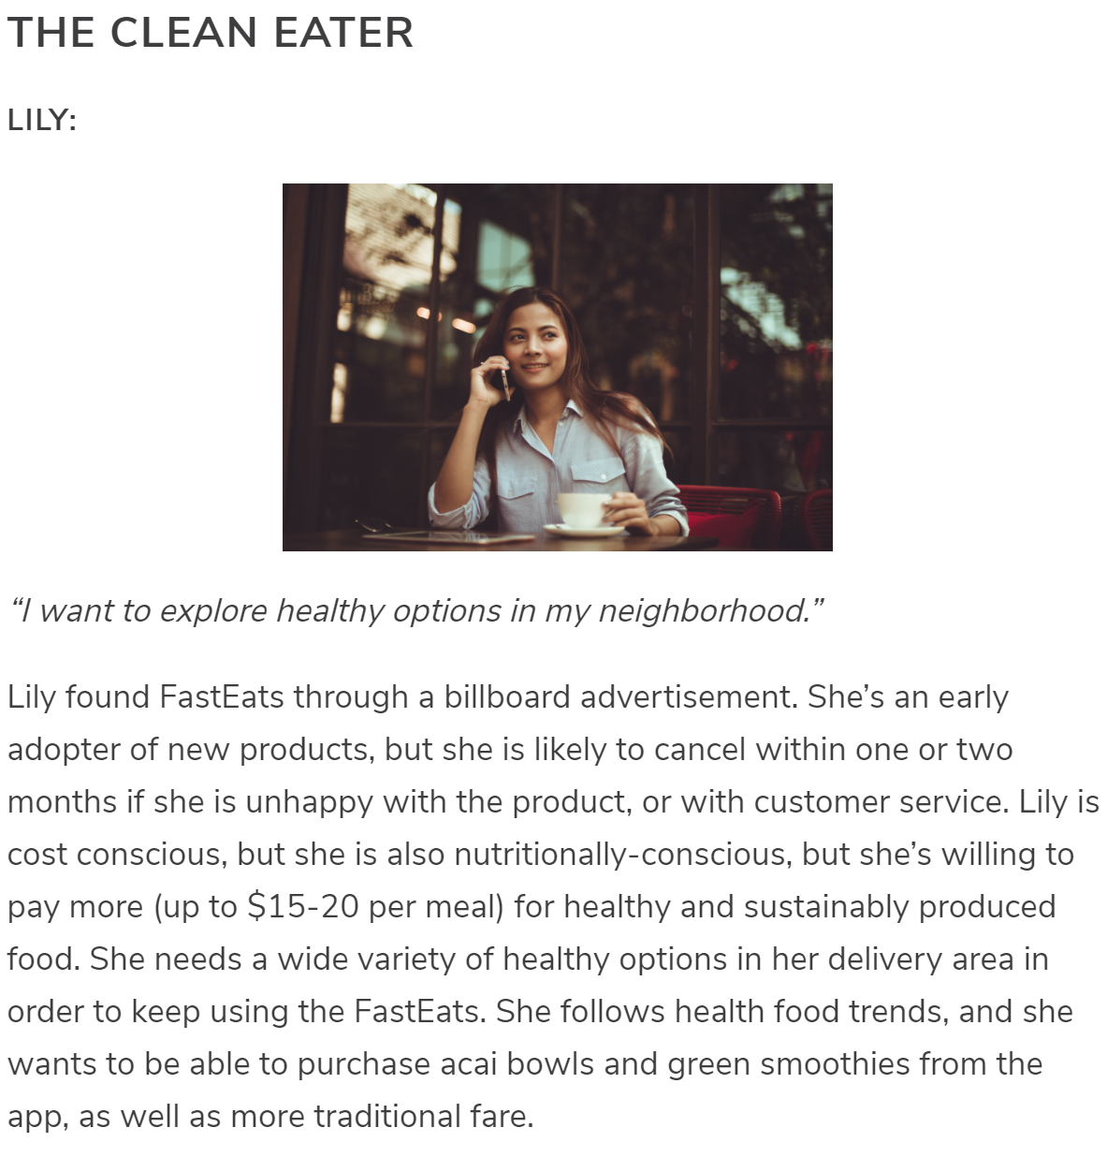
Personas
Example from https://www.codecademy.com/articles/ui-design-personas on a food delivery app (like Ele.me):

Slide 70
Summary
An “interface” acts as a ‘bridge’ between the user and the medium which assists us in completing tasks/achieving goals
“Interaction” includes physical interaction, eg, tapping/using gestures and cognitive interaction, eg when interpreting interface elements
A usable interface is easy to learn and easy to use
Visibility and affordance
Understanding users and how they work is a critical aspect of the designer’s role.
Personas are one of the most used methods for depicting user characteristics and needs.

Slide 71
Summary
Understanding users and how they work is a critical aspect of the designer’s role.
The traditional view of users as novice, intermediate and expect is no longer used.
Instead we view users as sitting on a usability spectrum from those who need help and those who don’t.
Personas are one of the most used methods for depicting user characteristics and needs.

Slide 72
Next time...
Understanding users and how they think

